Slide 1

STACK OVERFLOW DEVELOPER SURVEY 2024
Technology Trends, Job Market & Developer Demographics
Data Analytics Project
Ashwini Wadkar September 2026
From developer survey insights to data-driven decisions
01

Slide 2
OUTLINE
01
▤
Executive Summary
02
◉
Introduction
03
⚙
Methodology
04
▥
Results – Visualization (Charts) & Dashboard
05
⌕
Discussion – Findings & Implications
06
◎
Conclusion
STACK OVERFLOW DEVELOPER SURVEY 2024 | Technology Trends & Demographics
02

Slide 3
EXECUTIVE SUMMARY
KEY INSIGHTS AT A GLANCE
▥
Job Demand
$
Salary
C has the highest number of job postings: 25,114.
Swift has the highest annual average salary: $130,801.
</>
Programming Trends
DB
Database Trends
JavaScript leads current usage; JavaScript, SQL and TypeScript show strong future preference.
PostgreSQL leads current usage (25,910) and future preference (26,904).
DEMOGRAPHICS
• Ages 25–34 = 41.3% of respondents • Bachelor's degree holders = largest education group
STACK OVERFLOW DEVELOPER SURVEY 2024 | Technology Trends & Demographics
03

Slide 4
INTRODUCTION
WHY THIS ANALYSIS MATTERS
◎
Purpose
◉
Target Audience
!
Value
Analyze developer technology trends, job demand, salary patterns, future technology preferences, and respondent demographics.
Technology recruiters, hiring managers, and organizations planning future technology skills.
Identify in-demand technologies and emerging preferences to support data-driven technology and workforce decisions.
STACK OVERFLOW DEVELOPER SURVEY 2024 | Technology Trends & Demographics
04

Slide 5
METHODOLOGY
HOW THE ANALYSIS WAS DONE
01 DATA COLLECTION
02 WRANGLING
03 EDA
04 VISUALIZATION
Stack Overflow Developer Survey
SQL for data querying & extraction
Analyze Distributions and outliers
Matplotlib / Seaborn for Analysis Visualization
Job API → Job-posting data Analysis
Python & Pandas for data cleaning
Examine Relationships and correlations
IBM Cognos Analytics for interactive Dashboard
Web scraping → salary data Analysis
Handle missing values and duplicates
Calculate Summary statistics and grouped measures
PowerPoint for presenting findings
Cleaning, transformation and normalization
STACK OVERFLOW DEVELOPER SURVEY 2024 | Technology Trends & Demographics
05

Slide 6
RESULTS
KEY FINDINGS OVERVIEW
▥
Job Market
$
Salary
C leads job postings with 25,114 postings.
Swift has the highest annual average salary at $130,801.
</>
Technology Trends
◉
Demographics
JavaScript leads current usage; JavaScript, SQL and TypeScript show strong future preference.
Ages 25–34 are the largest group at 41.3%; Bachelor's degree holders are the largest group.
DATA → PATTERNS → INSIGHTS → DECISIONS
STACK OVERFLOW DEVELOPER SURVEY 2024 | Technology Trends & Demographics
06

Slide 7
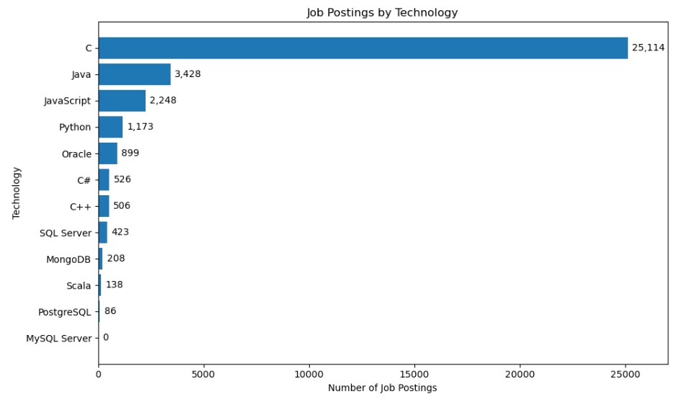
JOB POSTINGS
TOP LANGUAGES BY NUMBER OF JOB POSTINGS
KEY TAKEAWAY
C dominates the job-posting data, while Java, JavaScript and Python show comparatively strong demand.
Source: Job-posting API dataset
C = 25,114
STACK OVERFLOW DEVELOPER SURVEY 2024 | Technology Trends & Demographics
07

Slide 8
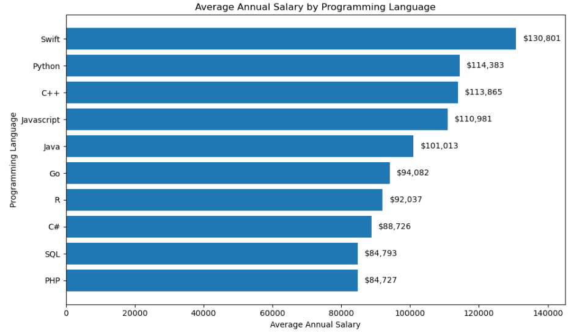
POPULAR LANGUAGES
USAGE, SALARY & INDUSTRY RELEVANCE
WHY IT MATTERS
Several widely used languages, including Python, JavaScript and Java, combine strong salaries with broad industry relevance.
Skill choice should balance market demand + salary + relevance.
STACK OVERFLOW DEVELOPER SURVEY 2024 | Technology Trends & Demographics
08

Slide 9
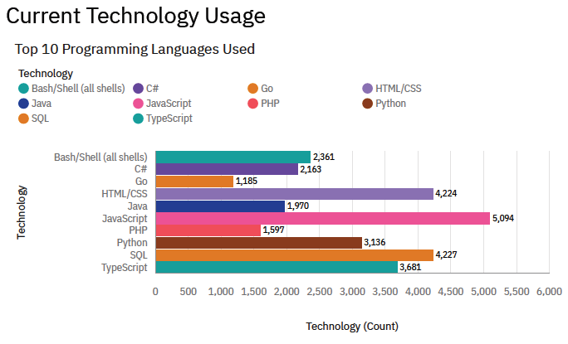
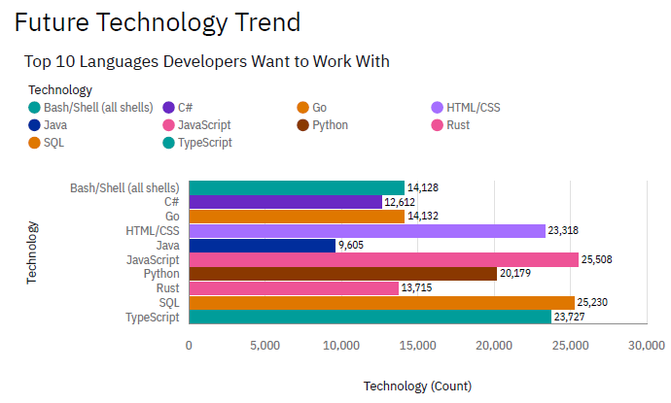
PROGRAMMING LANGUAGE TRENDS
CURRENT USAGE VS. FUTURE PREFERENCE
TOP 10 LANGUAGES DEVELOPERS USED
TOP 10 LANGUAGES DEVELOPERS WANT TO WORK WITH
STACK OVERFLOW DEVELOPER SURVEY 2024 | Technology Trends & Demographics
09

Slide 10
PROGRAMMING LANGUAGE TRENDS
FINDINGS & IMPLICATIONS
FINDINGS
IMPLICATIONS
JavaScript leads both current usage and future interest.
JavaScript should remain a key development skill.
SQL, TypeScript and HTML/CSS show strong future interest.
Broader skills across complementary technologies can improve career opportunities.
Python remains highly relevant across both periods.
Python is a strong long-term language to learn and develop.
STACK OVERFLOW DEVELOPER SURVEY 2024 | Technology Trends & Demographics
10

Slide 11
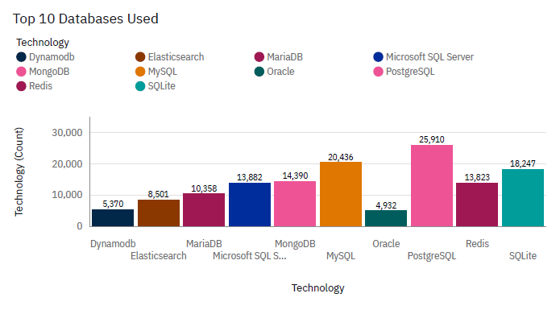
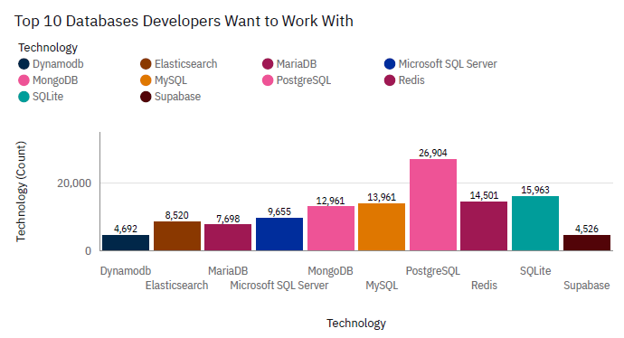
DATABASE TRENDS
CURRENT USAGE VS. FUTURE PREFERENCE
TOP 10 DATABASES USED BY DEVELOPERS
TOP 10 DATABASES DEVELOPERS WANT TO WORK WITH
STACK OVERFLOW DEVELOPER SURVEY 2024 | Technology Trends & Demographics
11

Slide 12
DATABASE TRENDS
FINDINGS & IMPLICATIONS
FINDINGS
IMPLICATIONS
PostgreSQL leads both current usage and future interest.
PostgreSQL shows the strongest future preference among surveyed developers.
Redis and Supabase show growing future interest.
Knowledge of both relational and modern database technologies is valuable.
MySQL has significantly lower future interest than current usage.
Future technology demand should guide database skill development.
STACK OVERFLOW DEVELOPER SURVEY 2024 | Technology Trends & Demographics
12

Slide 13
DASHBOARD
A UNIFIED VIEW OF KEY INSIGHTS
The dashboard brings together key insights from
Technology Trends and Developer Demographics.
TECHNOLOGY
DATABASES
DEMOGRAPHICS
Languages, databases & tools currently used
Technologies developers want to work with
Age, education & geographic profile
STACK OVERFLOW DEVELOPER SURVEY 2024 | Technology Trends & Demographics
13

Slide 14
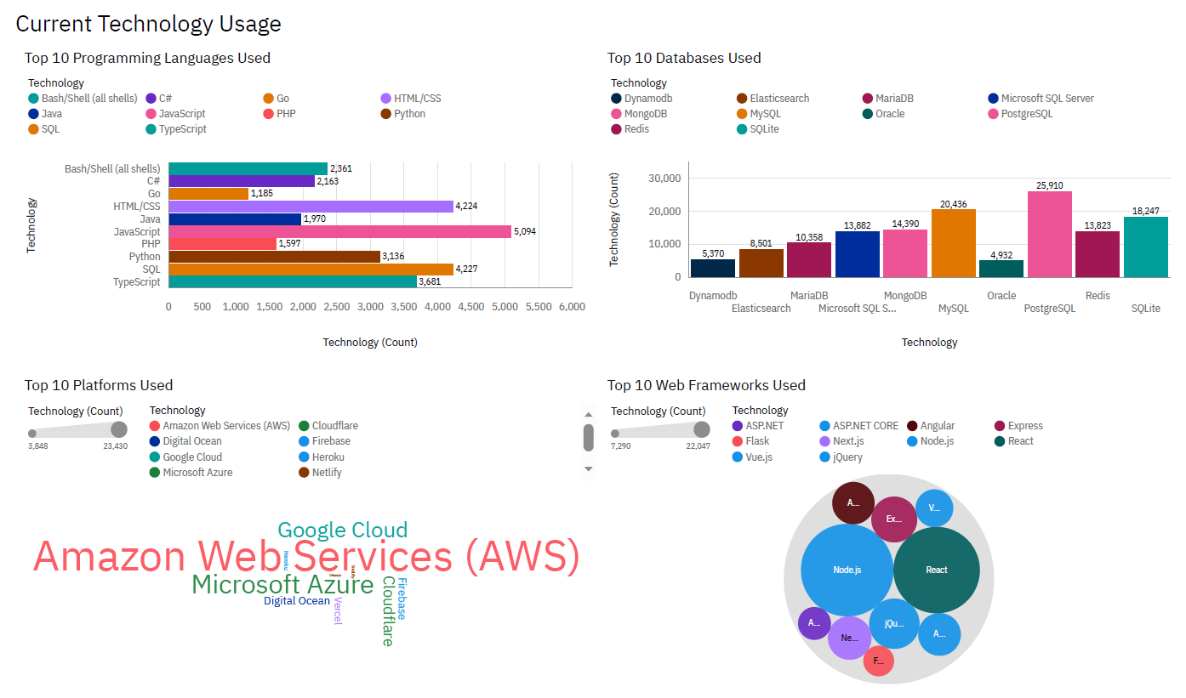
DASHBOARD TAB 1: CURRENT TECHNOLOGY USAGE
CURRENT TECHNOLOGY USAGE
KEY INSIGHTS
JavaScript leads current language usage.
PostgreSQL leads database usage.
AWS, Node.js and React are prominent technologies.
STACK OVERFLOW DEVELOPER SURVEY 2024 | Technology Trends & Demographics
14

Slide 15
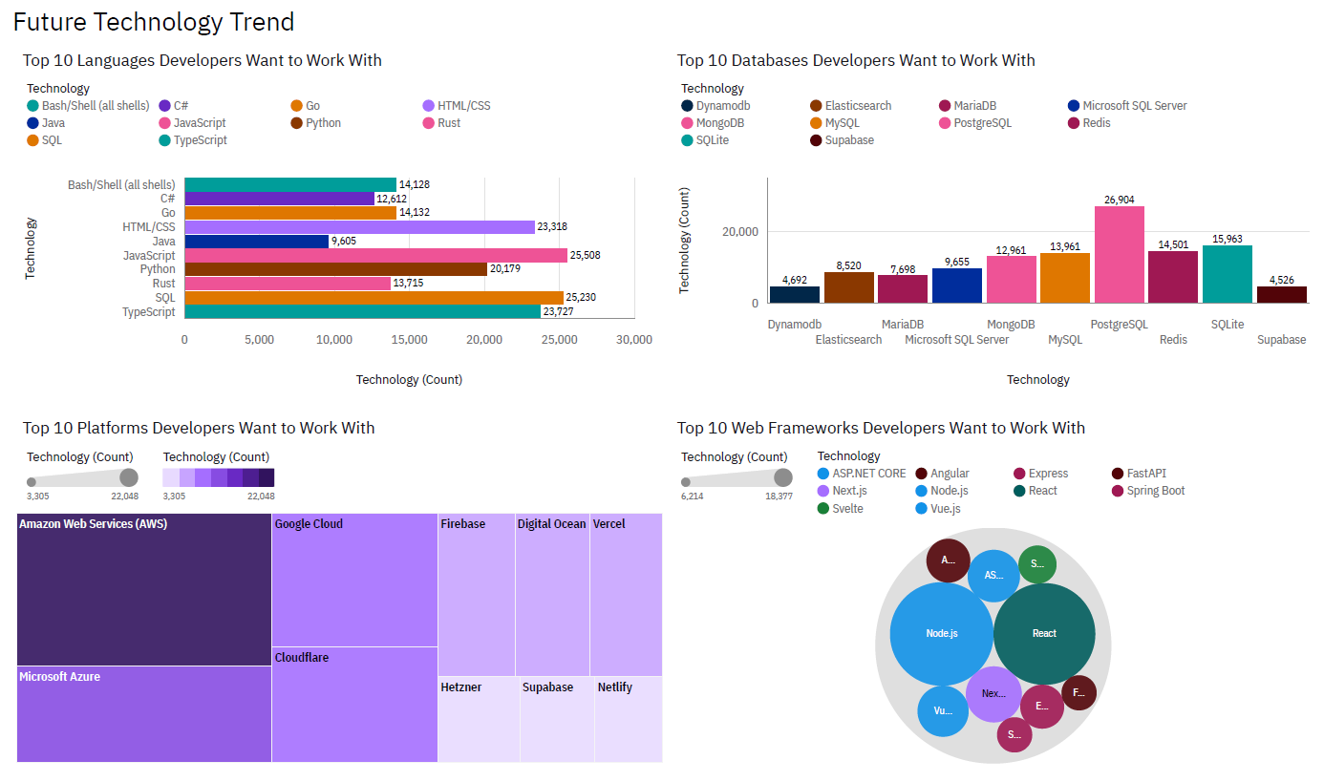
DASHBOARD TAB 2: FUTURE TECHNOLOGY TRENDS
FUTURE TECHNOLOGY TRENDS
KEY INSIGHTS
JavaScript, SQL and HTML/CSS lead future language interest.
PostgreSQL shows the strongest future database demand.
AWS, Azure, React and Node.js remain highly preferred technologies.
STACK OVERFLOW DEVELOPER SURVEY 2024 | Technology Trends & Demographics
15

Slide 16
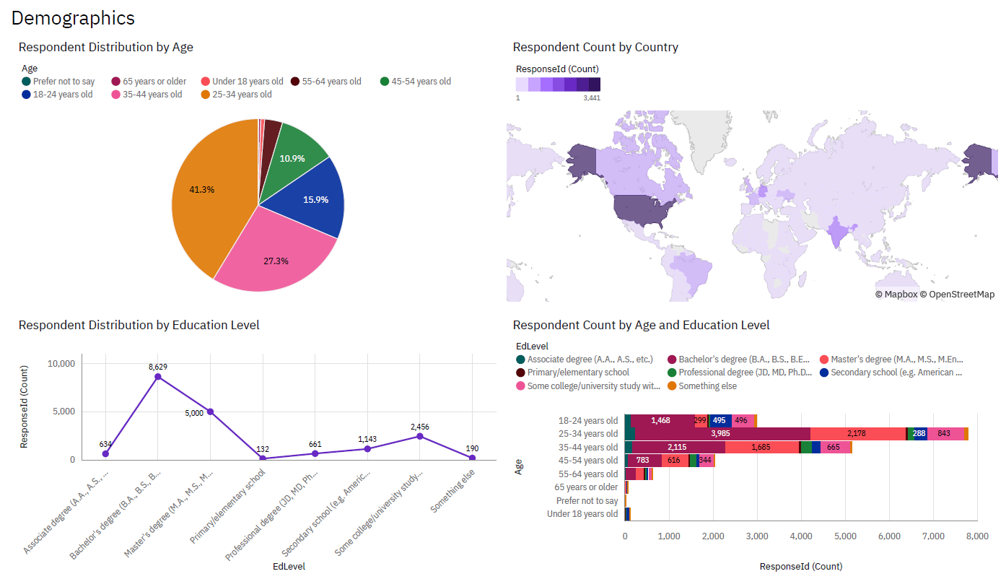
DASHBOARD TAB 3: DEMOGRAPHICS
DEMOGRAPHICS
KEY INSIGHTS
The 25–34 age group represents the largest share of respondents.
Bachelor’s degree holders make up the largest education group.
The survey represents a globally distributed developer community.
STACK OVERFLOW DEVELOPER SURVEY 2024 | Technology Trends & Demographics
16

Slide 17
DISCUSSION
INTERPRETING THE FINDINGS
⚙
Current Usage
↗
Future Trends
◎
Technology Shift
◉
Developer Profile
JavaScript, PostgreSQL, AWS and leading web frameworks such as React and Node.js are prominent in current usage.
JavaScript, SQL, PostgreSQL and major cloud/web technologies show strong future interest.
Comparison between current usage and future preferences highlights opportunities in emerging and evolving technologies.
Respondent base is largely younger, educated developers, with 25–34 the largest segment and respondents distributed globally.
STACK OVERFLOW DEVELOPER SURVEY 2024 | Technology Trends & Demographics
17

Slide 18
OVERALL FINDINGS & IMPLICATIONS
FROM DATA TO ACTION
FINDINGS
IMPLICATIONS
JavaScript and PostgreSQL show strong current and future demand.
Prioritize skills aligned with strong current and future demand.
Modern web, database and cloud technologies remain highly relevant.
Continuous upskilling is essential as technology preferences evolve.
The respondent population is predominantly young and educated.
Organizations can use these trends to guide hiring, training and technology planning.
STACK OVERFLOW DEVELOPER SURVEY 2024 | Technology Trends & Demographics
18

Slide 19
CONCLUSION
KEY TAKEAWAYS
1
JavaScript and PostgreSQL remain highly relevant technologies.
2
Cloud and web technologies such as AWS, React and Node.js show strong future relevance.
3
Continuous upskilling is important as technology trends evolve.
4
The analysis provides insights to guide technology learning, hiring and investment decisions.
STACK OVERFLOW DEVELOPER SURVEY 2024 | Technology Trends & Demographics
19

Slide 20
DATA SOURCES & REFERENCES
FROM DATA TO ACTION
DATA SOURCES
https://cf-courses-data.s3.us.cloud-object-storage.appdomain.cloud/IBM-DA0321EN-SkillsNetwork/labs/module%201/Accessing%20Data%20Using%20APIs/jobs.json - Stack Overflow Developer Survey 2024
https://cf-courses-data.s3.us.cloud-object-storage.appdomain.cloud/IBM-DA0321EN-SkillsNetwork/labs/datasets/Programming_Languages.html - Web-Scraped Salary Dataset
https://cf-courses-data.s3.us.cloud-object-storage.appdomain.cloud/n01PQ9pSmiRX6520flujwQ/survey-data.csv - Stack Overflow Developer Survey 2024 Original source - Unpacking the 2024 Developer Survey results - Stack Overflow
TOOLS & TECHNOLOGIES
Python • Pandas • NumPy • SQL • Matplotlib • Seaborn • APIs & Web Scraping • IBM Cognos Analytics • JupyterLab
STACK OVERFLOW DEVELOPER SURVEY 2024 | Technology Trends & Demographics
18

